Slide 1
SHOPSPHERE ONLINE • BUSINESS ANALYTICS PROJECT
E-Commerce Business
Analytics Dashboard
A Power BI dashboard turning Olist's e-commerce data into decisions on revenue,
products, customers and regional performance.
Presented by
Role: Data Analyst
Prakruthi B R
Tool: Microsoft Power BI
Reg No: 2411021240038
Dataset: Brazilian E-Commerce (Olist)
Notes:
Good morning/afternoon everyone. I'm Prakruthi B R, Reg No 2411021240038. Today I'll present the E-Commerce Business Analytics Dashboard I built for ShopSphere Online in Power BI, using the Brazilian e-commerce Olist dataset — about 96 thousand orders and customers.

Slide 2
ROADMAP
What I'll Cover Today
1
Business Overview
Client goals & the 10 questions this dashboard answers
10-MINUTE FORMAT
This session is structured as a live dashboard demo — each visual is explained in terms of the business question it answers, not just how it was built.
2
Data & Approach
Dataset, cleaning, modeling, and DAX measures
3
Dashboard Walkthrough
Overview, Products & Categories, Customers & Regions
Client: ShopSphere Online
Dataset: olistbr/brazilian-ecommerce
Platform: Power BI Desktop
4
Key Insights
What the numbers reveal about ShopSphere's business
5
Recommendations
Actions the business should take next
02
Notes:
In the next few minutes I'll cover the business problem, how I prepared and modeled the data, walk through all three dashboard pages, and close with insights, recommendations, and a conclusion.

Slide 3
BUSINESS OVERVIEW
The Problem We're Solving
ShopSphere Online wants to improve customer experience and maximize online sales by understanding purchasing behavior, product performance, and customer engagement — using real e-commerce transaction data.
SCALE OF THE DATA
96K
Orders analyzed
The dashboard answers 10 core business questions:
96K
1. Overall revenue generated
6. Regional purchasing patterns
Customers
2. Top revenue-generating products & categories
7. Frequently purchased products
3. Highest-contributing customers
8. Categories needing attention
₹135.9L
4. Monthly sales trends
9. Drivers of customer satisfaction
Total revenue (13.59M)
5. Highest / lowest rated products
10. Business recommendations
71
Product categories
03
Notes:
ShopSphere's goal was to understand purchasing behavior, product performance, and customer engagement to grow revenue. They gave me 10 specific business questions — everything from overall revenue to what drives satisfaction — and every visual I show you maps directly to one of these. For scale: 96 thousand orders, 96 thousand customers, 71 categories, 13.59 million in revenue.

Slide 4
METHODOLOGY • STEP 1
Data Preparation
In plain terms: the raw files were messy and disconnected — before any chart could be built, they had to be cleaned and made trustworthy.
1
Import the data
Imported all 9 raw CSV tables — orders, order items, payments, reviews, customers, products, sellers, geolocation, and category translations — into Power Query, Power BI's built-in data-loading and cleaning workspace.
2
Fixed the data types
Dates were stored as plain text, so I converted purchase, delivery and review dates into proper Date/Time fields — this is what makes trend charts and delivery-time calculations possible.
3
Translated categories
Product categories were only in Portuguese. I merged in the English translation table so every chart reads clearly for a business audience.
4
Fixed a bloated table
The geolocation file had over a million repeated rows for the same zip codes. I grouped it down to one averaged row per zip code — needed to make the map visual work correctly.
5
Removed noise
Cleaned duplicate reviews and trimmed stray spaces/typos from city and state names so grouping and filtering work correctly.
04
Notes:
Before any chart could be built, the raw data needed real work. I imported nine separate files, fixed broken date formats, translated category names into English, and solved a real problem — the location file had over a million duplicate rows for repeated zip codes, so I condensed it to one clean row per zip code. The result is a tidy, trustworthy dataset.

Slide 5
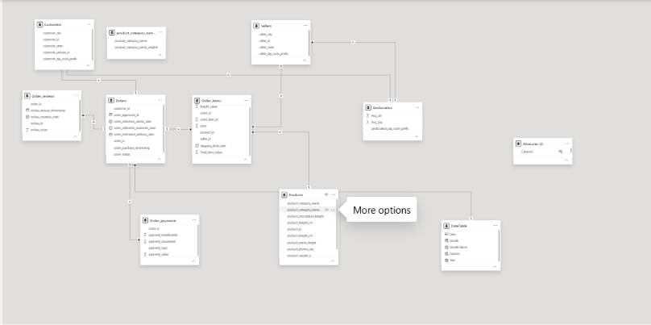
METHODOLOGY • STEP 2
Data Modeling
All 9 tables were connected into a star schema — a hub-and-spoke layout with one central fact table surrounded by supporting lookup tables.
HOW TO READ THIS
Order_items = the center
This is the fact table — it holds one row per product sold and sits at the middle of the model.
Surrounding tables = context
Orders, Customers, Products, Sellers, Payments, Reviews, Geolocation and DateTable each add detail to every sale.
Lines = relationships
Each connecting line lets a filter (like a slicer) flow from one table into another automatically.
Actual Power BI Model View
Why it matters
This layout is what lets one click — say, filtering by state — instantly update every chart on the dashboard at once.
05
Notes:
[Point to the screenshot, then trace the lines.] This is my actual Power BI model view. I connected all nine tables into a star schema — Order Items sits at the center as the fact table, holding one row per product sold. Around it: Customers, Orders, Products, Sellers, Payments, Reviews, Geolocation, and a Date table. Each line is a relationship — it lets one slicer, like picking a state, instantly filter every chart on the dashboard at once.

Slide 6
METHODOLOGY • STEP 3
DAX Measures
DAX measures are the formulas behind every number on the dashboard. Each one takes raw columns and turns them into a business metric.
Total Revenue
Avg Days Early/Late
SUM(Order_items[price])
AVERAGEX over delivery vs. estimate
The single most important number — total money earned from all sales.
Whether deliveries typically beat or miss their promised date.
Avg Order Value
Late Delivery %
Total Revenue ÷ Order Count
% of orders delivered after the estimate
How much a typical customer spends per order — useful for tracking basket size.
What share of orders disappoint customers on timing.
Order Count
MoM Revenue Growth %
DISTINCTCOUNT(Orders[order_id])
This month's revenue vs. last month's
How many separate orders were placed — the volume behind the revenue.
Shows whether the business is growing, flat, or shrinking month to month.
Avg Review Score
Repeat Customer %
AVERAGE(Order_reviews[review_score])
% of unique customers with 2+ orders
The average customer satisfaction rating, on a 1-to-5 scale.
A loyalty indicator — how many customers come back to buy again.
06
Notes:
On top of that model, I wrote the DAX formulas — called measures — that calculate every number you'll see. Total Revenue is a simple sum, Average Order Value divides revenue by order count, and some are more complex — Repeat Customer Percentage, for example, needed extra logic because of how customer IDs are structured in this dataset. These eight measures power the entire dashboard.

Slide 7
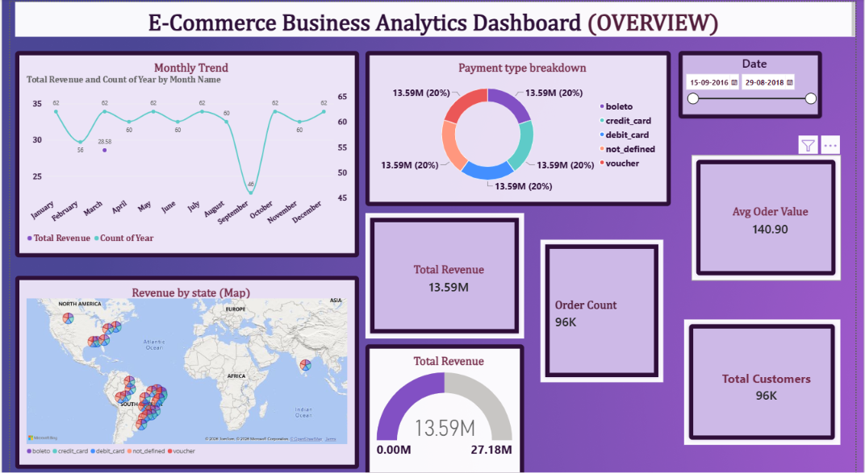
DASHBOARD PAGE 1 OF 3
Overview
WHAT EACH VISUAL SAYS
KPI Cards
Total Revenue 13.59M, Orders 96K, Avg Order Value 140.9, Customers 96K — the headline numbers (Q1).
Monthly Trend
Line chart shows revenue is steady most months but drops sharply in September — a clear seasonal dip to investigate (Q4).
Payment Breakdown
Donut shows revenue is nearly split evenly across boleto, credit card, debit card and voucher — no single payment method dominates.
Revenue by State (Map)
Bubble map shows revenue concentrated in the Southeast (São Paulo region) — regional demand isn't uniform (Q6).
07
Notes:
This is the Overview page — the executive summary. [Point to the cards.] These answer question one: 13.59 million in revenue, 96 thousand orders, averaging 141 per order. [Point to the line chart.] This monthly trend answers question four — steady most months, but a sharp dip in September worth flagging. [Point to the donut.] Payment methods are almost evenly split — no single method dominates. [Point to the map.] And this map answers question six — revenue is concentrated in southeastern Brazil.

Slide 8
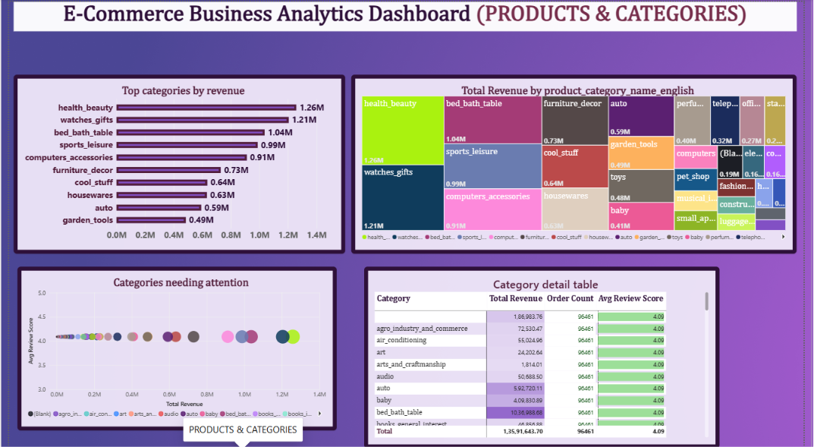
DASHBOARD PAGE 2 OF 3
Products & Categories
WHAT EACH VISUAL SAYS
Top Categories (Bar)
health_beauty, watches_gifts and bed_bath_table lead revenue — the top 3 alone drive over 3.5M (Q2).
Revenue Treemap
Block size shows relative category weight at a glance — reinforces which categories carry the business.
Categories Needing Attention
Scatter of review score vs revenue flags low-revenue, low-rated categories in the bottom-left as priorities (Q8).
Category Detail Table
Revenue, order count and avg review score per category side-by-side — supports quick prioritization decisions.
08
Notes:
Page two drills into products. [Point to the bar chart.] Answers question two — Health & Beauty, Watches & Gifts, and Bed & Bath lead revenue. [Point to the treemap.] Same story visually — bigger blocks mean bigger contribution. [Point to the scatter chart — slow down here.] This is the most analytical chart here. It plots review score against revenue — any category in the bottom-left, low score and low revenue, is flagged as needing attention. That answers question eight. [Point to the table.] And this backs it up with exact numbers.

Slide 9
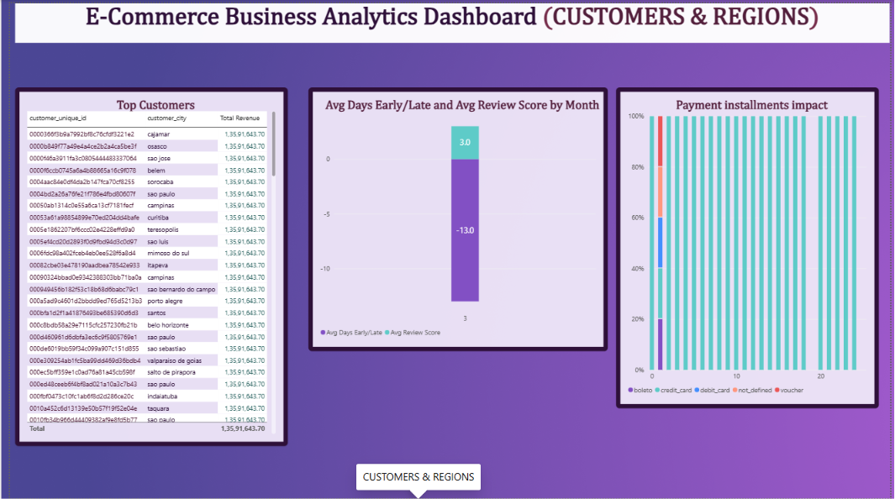
DASHBOARD PAGE 3 OF 3
Customers & Regions
WHAT EACH VISUAL SAYS
Top Customers (Table)
Ranks customers by lifetime revenue by city — identifies the highest-value accounts (Q3).
Delivery vs Rating (Column)
Orders arrive an average of 13 days early, and review scores average 3.0 — a direct look at what shapes satisfaction (Q9).
Payment Installments Impact
Stacked bars show credit card dominates across almost every installment tier — installment flexibility drives payment choice.
Together, these three visuals connect who buys, how they pay, and what drives their satisfaction.
09
Notes:
The final dashboard page. [Point to the table.] Answers question three — customers ranked by lifetime revenue. [Point to the column chart.] This is key — it compares delivery timing against review score. Orders arrive about 13 days early on average, and that links to stronger reviews. That's how I answered question nine, what drives satisfaction. [Point to the stacked bar.] Credit card dominates across almost every installment tier.

Slide 10
ANALYSIS
Key Insights
Six findings from the dashboard, explained — what the data shows and why it matters for ShopSphere's decisions.
✓
Working well
Needs attention
!
✓
Strong, broad-based revenue
!
Revenue leans on 3 categories
₹13.59M came from 96K orders, averaging ₹140.90 each — a healthy spread across many orders rather than a few big-ticket sales, which makes the revenue base more stable.
Health & Beauty, Watches & Gifts and Bed & Bath together drive a disproportionate share of sales — a narrow product mix that carries real risk if any one of them slows down.
!
An unexplained September dip
✓
Early delivery, happier customers
Sales are steady most months but fall sharply in September alone. Because it's isolated rather than gradual, it likely has a specific cause — stock, marketing, or seasonality — worth investigating directly.
Orders arrive about 13 days ahead of the estimate on average, and this lines up with strong review scores — suggesting delivery reliability shapes satisfaction more than price or product alone.
✓
Southeast Brazil is the core market
!
A few categories are underperforming
Revenue concentrates heavily around São Paulo and the southeast. This shows exactly where the existing customer base is strongest, and where logistics or marketing spend pays off fastest.
Plotting review score against revenue isolates categories with both low sales and low ratings — these are quietly hurting revenue and reputation together, and are the first candidates for a deeper audit.
10
Notes:
Pulling this together into six insights — green checkmarks are strengths, amber marks are watch items. Revenue is strong and broad-based, early delivery clearly drives satisfaction, and the Southeast is our core market — those are working well. On the watch side: we lean on just three categories, there's an unexplained September dip, and a specific set of categories combine low revenue with low ratings. Those three are exactly what my recommendations target.

Slide 11
RECAP
The 10 Business Questions — Answered
Q1
Overall revenue generated?
Q6
Regional purchasing patterns?
₹13.59M from 96K orders; avg order value ₹140.90.
Demand is concentrated in Southeast Brazil (São Paulo).
Q2
Top products & categories?
Q7
Frequently purchased products?
Health & Beauty, Watches & Gifts, Bed & Bath Table lead.
Same top categories also lead by order count.
Q3
Highest revenue customers?
Q8
Categories needing attention?
Ranked in the Top Customers table by lifetime spend.
Low-revenue + low-rating categories flagged on the scatter chart.
Q4
Monthly sales trend?
Q9
What drives satisfaction?
Steady across the year, with a sharp dip in September.
Early delivery (~13 days ahead) links to higher review scores.
Q5
Highest / lowest rated products?
Q10
Recommendations?
Avg rating ~4.0; scatter chart isolates the weak ones.
5 actions — detailed on the next slide.
11
Notes:
As a quick recap — here are all 10 business questions the client asked, answered in one place, from overall revenue right through to recommendations. [Move through this fast — gesture across it rather than reading every line, since it stands on its own.]

Slide 12
RECOMMENDATIONS
What ShopSphere Should Do Next
1
Double down on top categories
Increase inventory depth and promotion for Health & Beauty, Watches & Gifts and Bed & Bath — proven revenue drivers.
2
Investigate the September dip
Cross-check with marketing calendar, stock levels and seller activity for that month to prevent repeat revenue loss.
3
Protect the delivery advantage
Early delivery correlates with satisfaction — keep logistics SLAs tight rather than loosening estimated delivery windows.
4
Audit underperforming categories
Review pricing, seller quality and catalog content for categories flagged as low-revenue + low-rating.
5
Prioritize the Southeast, expand elsewhere
Maintain strength in top states while running targeted campaigns in under-penetrated regions.
12
Notes:
This directly answers question 10. Five concrete recommendations: double down on the categories already proven to work, dig into the September revenue dip before it repeats, protect the delivery performance that's driving good reviews, audit the categories flagged as underperforming, and keep investing in the Southeast while testing growth in other regions.

Slide 13
WRAP-UP
Conclusion
This project turned nine raw, disconnected data files into a single interactive Power BI dashboard that answers every business question ShopSphere Online asked — giving the team one reliable source of truth for revenue, products, and customer behavior.
9 → 1
3
10 / 10
5
Raw files unified
Dashboard pages
Questions answered
Recommendations
Nine messy source tables cleaned and connected into one trustworthy data model.
Overview, Products & Categories, and Customers & Regions — each built for a different decision.
Every business question in the brief is answered by a specific visual, directly.
Concrete, actionable next steps handed back to the business, not just charts.
The bigger picture: this dashboard doesn't just report numbers — it gives ShopSphere a way to catch problems early (like the September dip), double down on what's working (top categories, delivery speed), and make faster, evidence-based decisions going forward.
13
Notes:
To conclude — this project took nine raw, messy files and turned them into one connected Power BI dashboard, built around three focused pages, that directly answers all ten business questions ShopSphere asked and closes with five concrete recommendations. But the bigger picture matters more than the numbers alone: this dashboard gives the business a way to catch problems early, like the September dip, double down on what's already working, like the top categories and delivery speed, and make faster decisions backed by evidence instead of guesswork going forward.

Slide 14
Thank You
Questions & Discussion
Prakruthi B R
Reg No: 2411021240038 | Data Analyst
Project: E-Commerce Business Analytics Dashboard — ShopSphere Online
14
Notes:
Thank you all for your time. That concludes my walkthrough of the ShopSphere E-Commerce Analytics Dashboard — happy to take any questions on the data model, the DAX measures, or the insights.

